Slide 1
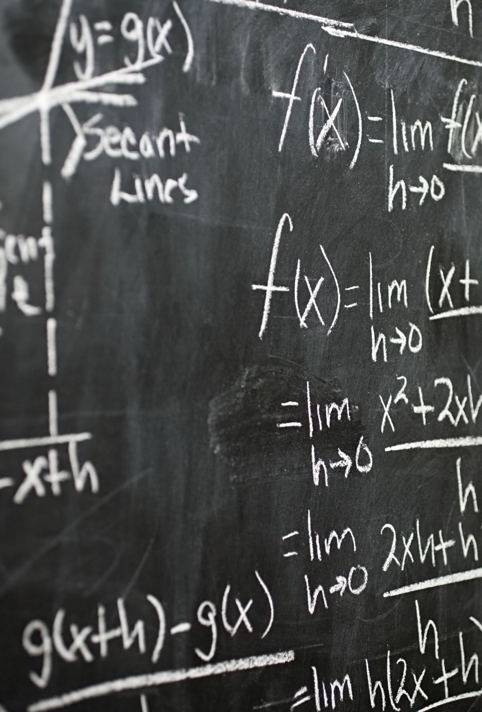
Recurrence Equations

Slide 2
A recurrence is an equation or inequality that describes a function in terms of its value on smaller inputs.
Recurrences are generally used in divide-and-conquer paradigm.
Let us consider T(n) to be the running time on a problem of size n.
If the problem size is small enough, say n < c where c is a constant, the straightforward solution takes constant time, which is written as θ(1).
If the division of the problem yields a number of sub-problems with size (n/b)

Slide 3
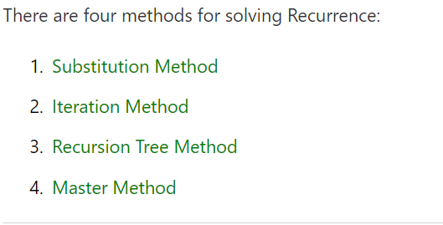

Slide 4
Iteration method

Slide 5
Iteration method
Convert recurrence to summation and try to bound using known series
Iterate recurrence until initial condition reached
Use back substitution method to express recurrence in terms of n and initial(boundary) condition
Example problems

Slide 6
        1+T(n-1) ; n>1
Problem 1) T( n)= {
              ; n=1
Problem 2) T(n)= { C+T(n-1) ; n>1
C ; n=1
Problem 3) T( n)= { n + T(n-1) ; n>1
1 ;n=1

